Slide 1

PJM HOURLY ENERGY CONSUMPTION
PROJECT - 01 : GROUP - 03
FINAL REVIEW PRESENTATION
GROUP MEMBERS -
DEEPESH, DEVA DHARSHINI, SUJAL,
SHIVA, VIVEK, SRAVYA.

Slide 2

BUSINESS OBJECTIVE :
ABOUT DATASET :-
PJM Interconnection LLC (PJM) is a regional transmission organization (RTO) in the United States. It is part of the Eastern Interconnection grid operating an electric transmission system serving all or parts of Delaware, Illinois, Indiana, Kentucky, Maryland, Michigan, New Jersey, North Carolina, Ohio, Pennsylvania, Tennessee, Virginia, West Virginia, and the District of Columbia. The hourly power consumption data comes from PJM's website and are in megawatts (MW).
PROBLEM STATEMENT :-
Split the last year into a test set- can you build a model to predict energy consumption.
Find trends in energy consumption around hours of the day, holidays, or long term trends.
Understand how daily trends change depending of the time of year. Summer trends are very different than winter trends.
Forecast for next 30 days.

Slide 3
PROJECT FLOW :
Understanding the problem statement
EDA (Exploratory Data Analysis)
→ Data Pre-processing
→ Data cleaning
→ Visualization
→ Outlier Detection
→ Outlier Removal
Model Building
→ 5 Models
→ Choosing The Final Model
→ Forecast For Next 30 Days
Model Deployment

Slide 4
PHASE - 1
EXPLORATORY DATA ANALYSIS (EDA)

Slide 5
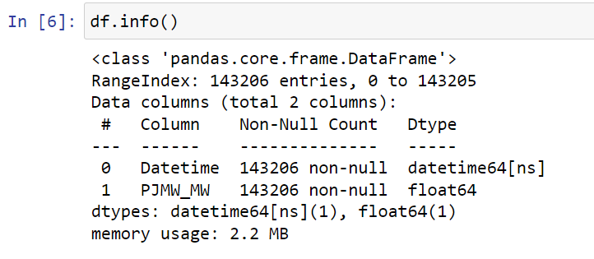
Data Information

Slide 6
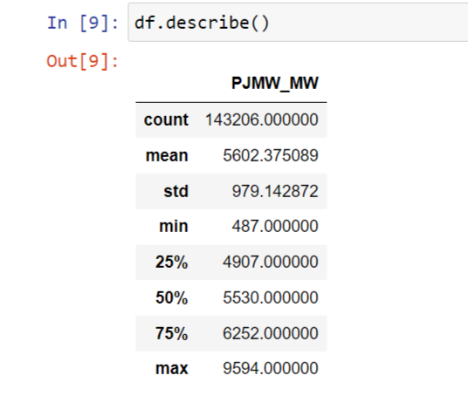
Data Description

Slide 7
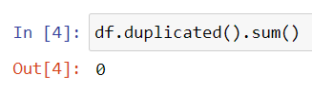
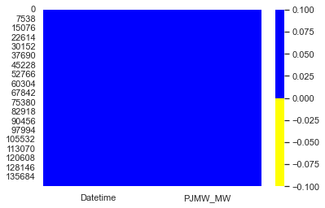
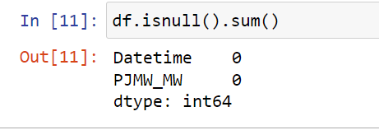
Checking for Null Values

Slide 8
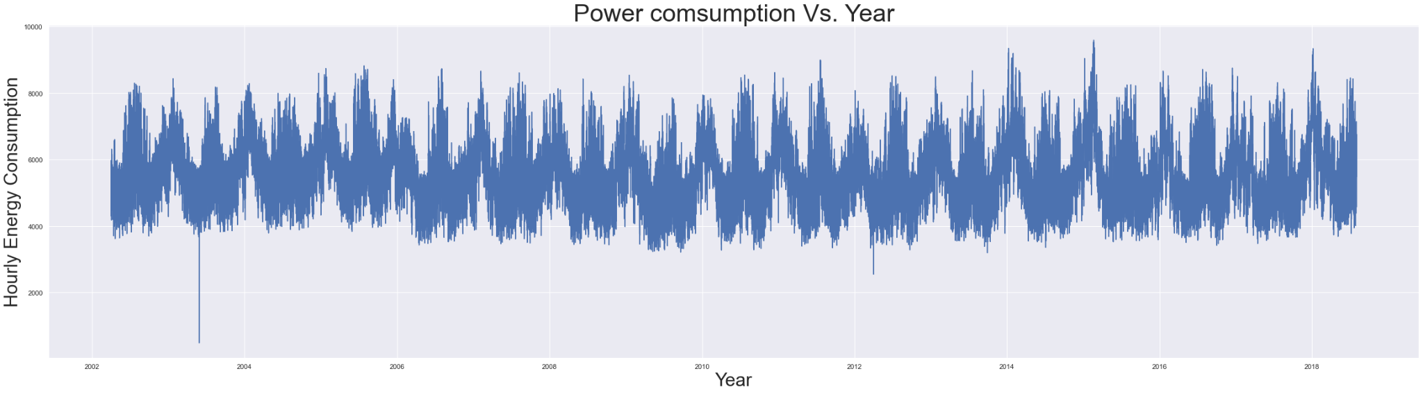
Plotting the data

Slide 9
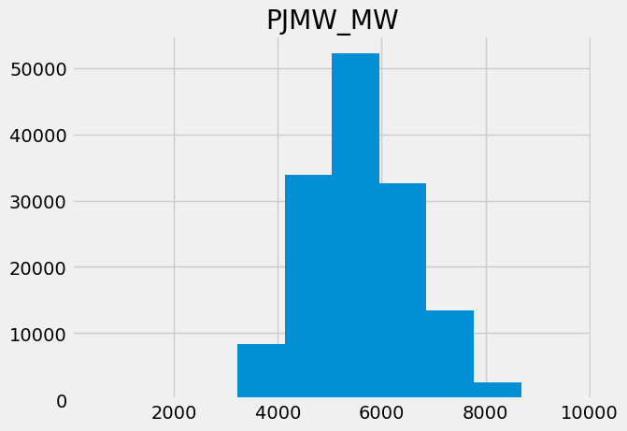
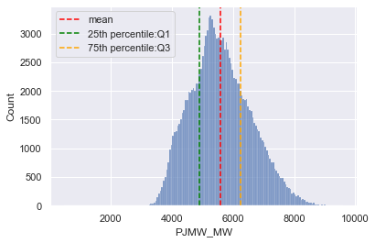
Histogram

Slide 10
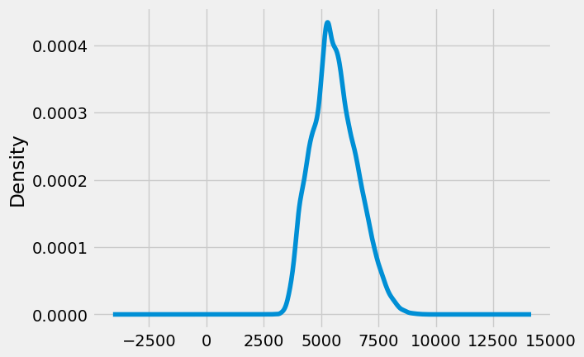
Density Plot

Slide 11
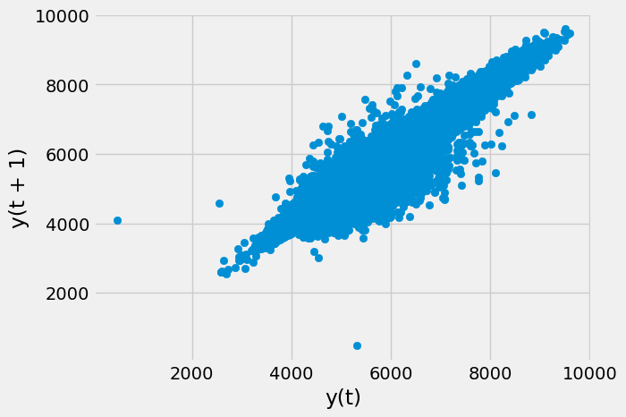
Lag Plot

Slide 12
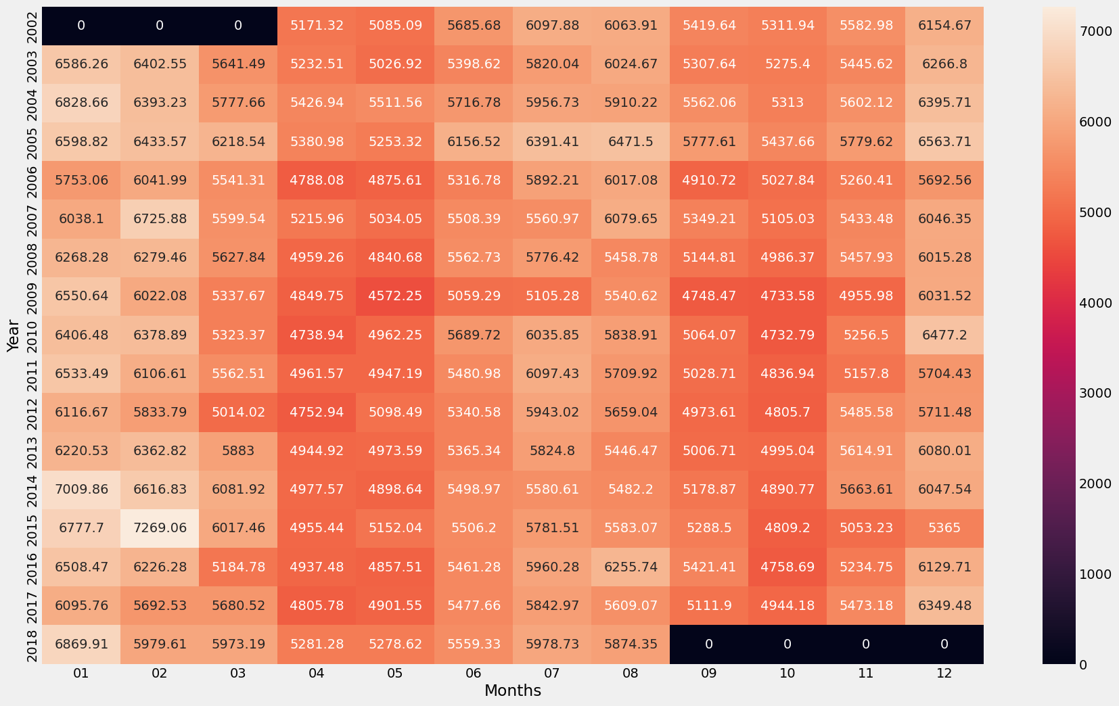
Heatmap

Slide 13
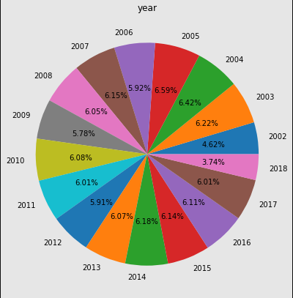
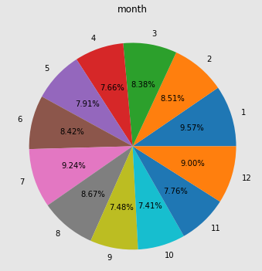
Pie Chart

Slide 14
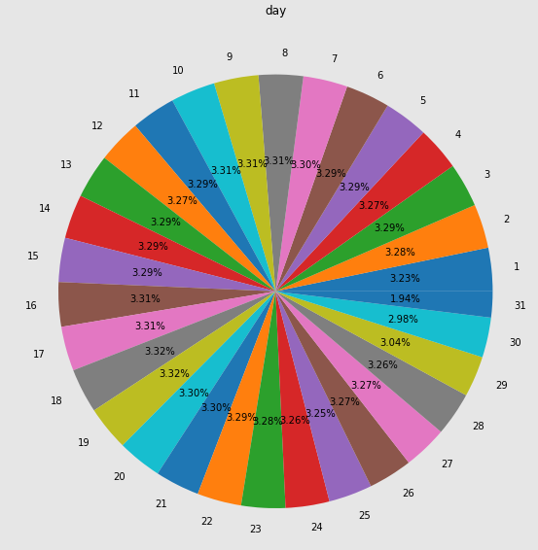
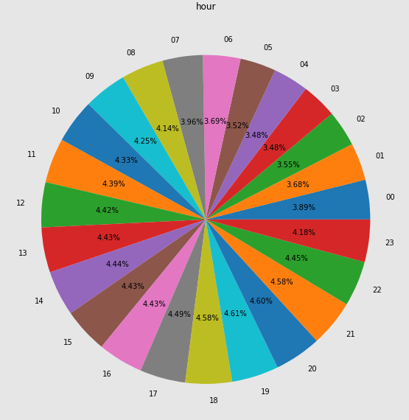
Pie Chart

Slide 15
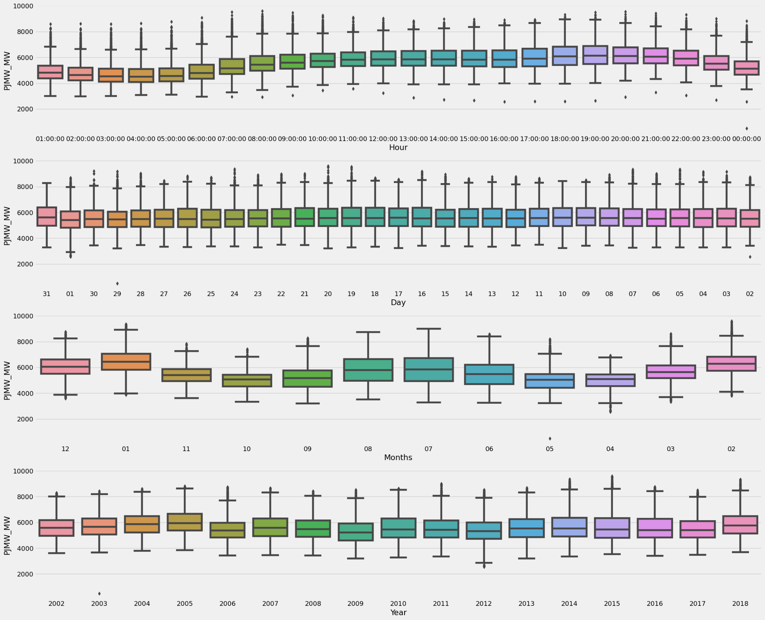
Box Plot

Slide 16
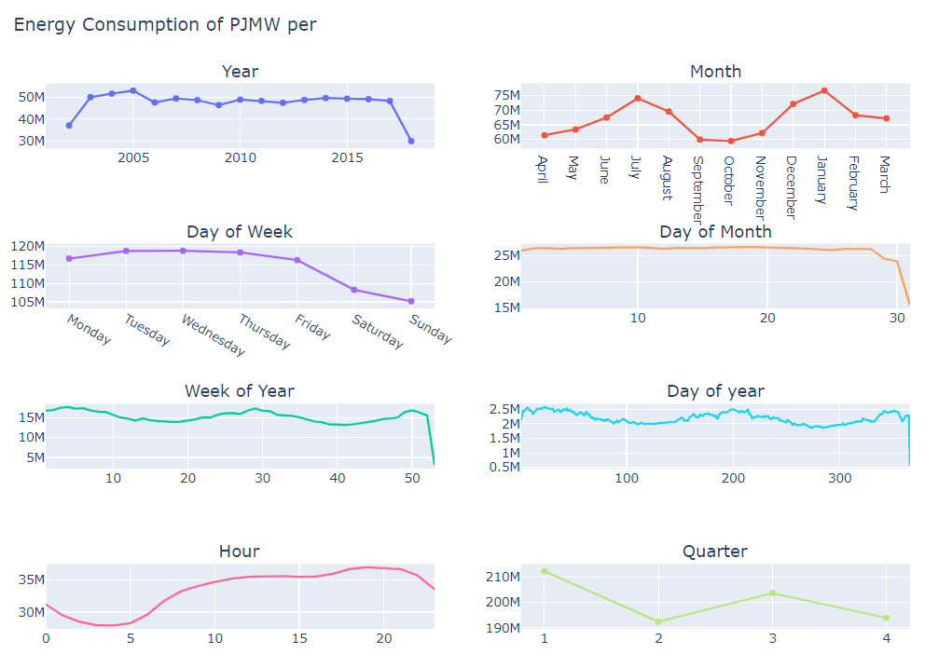
Line Plot

Slide 17
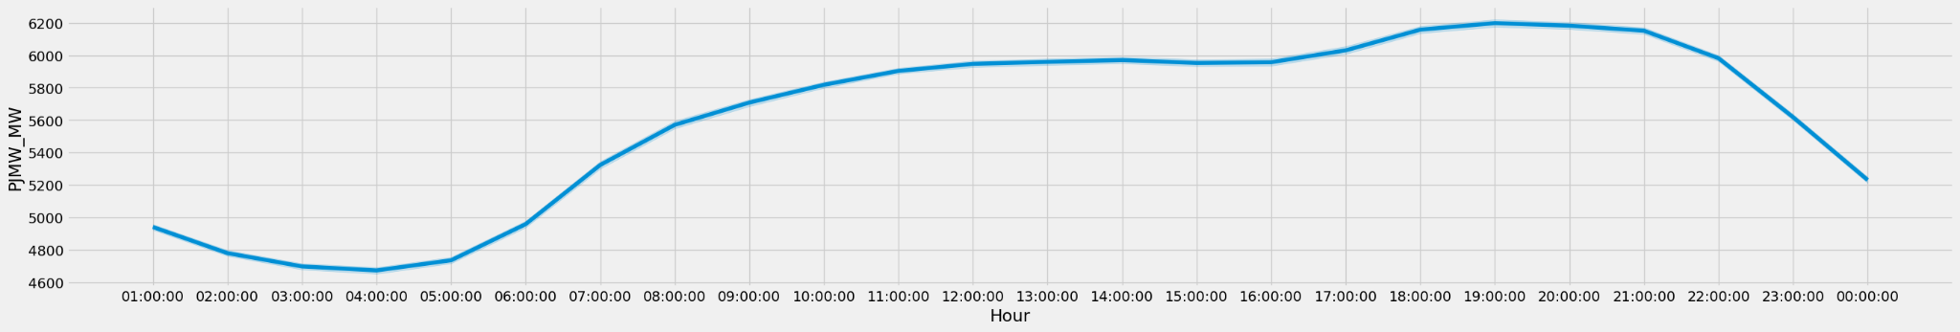
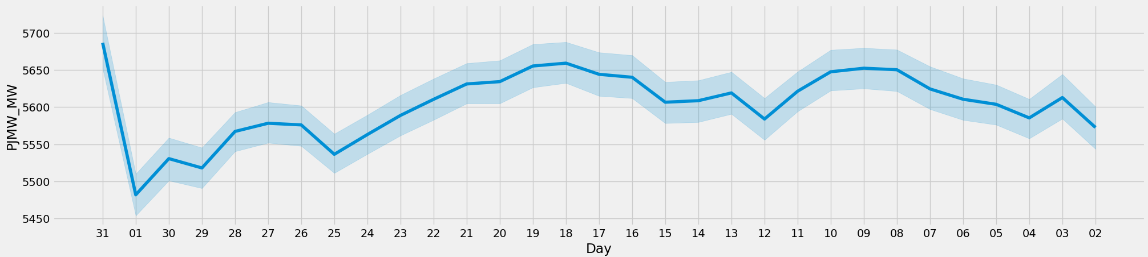
Line Plot

Slide 18
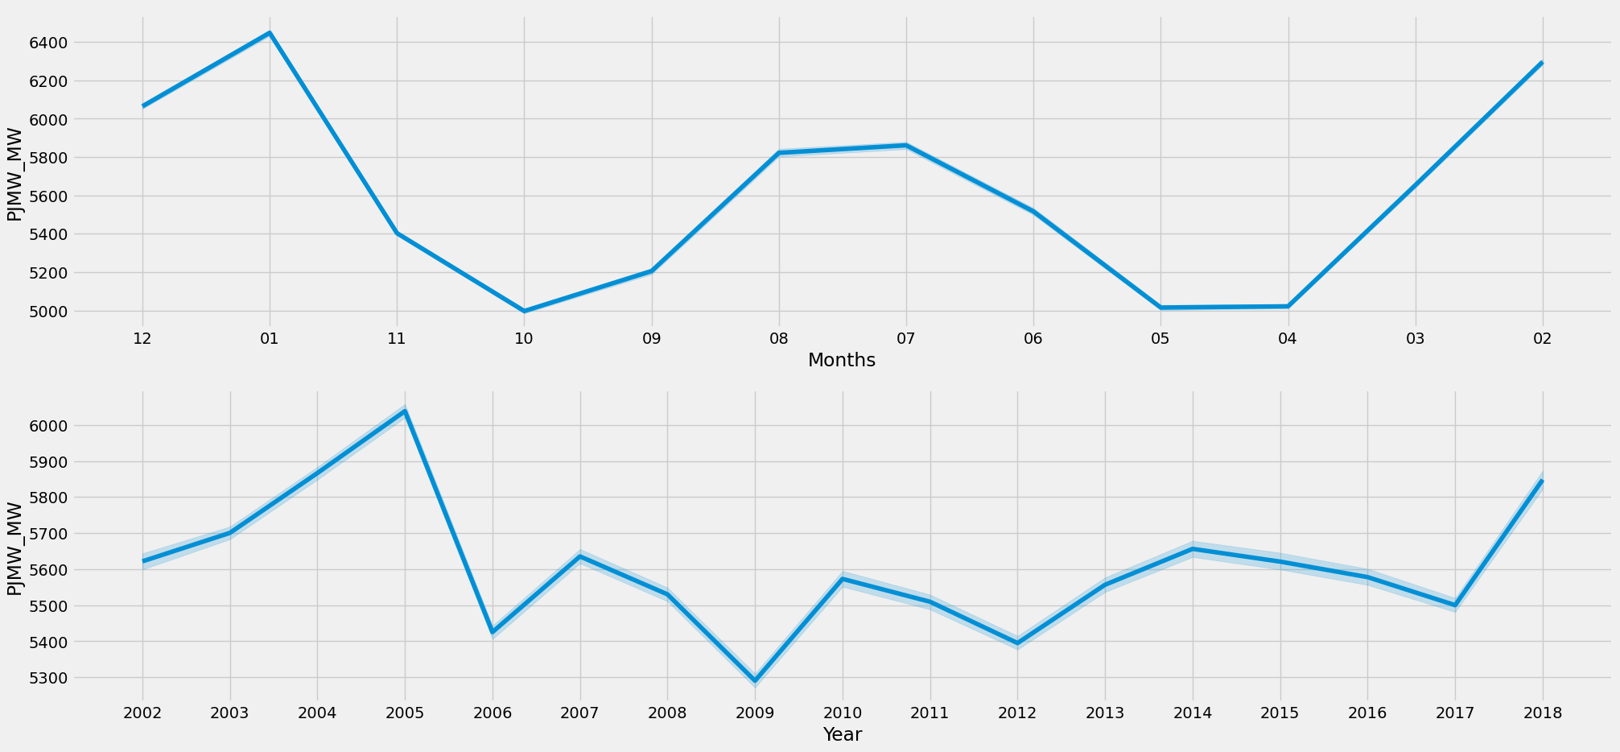

Slide 19
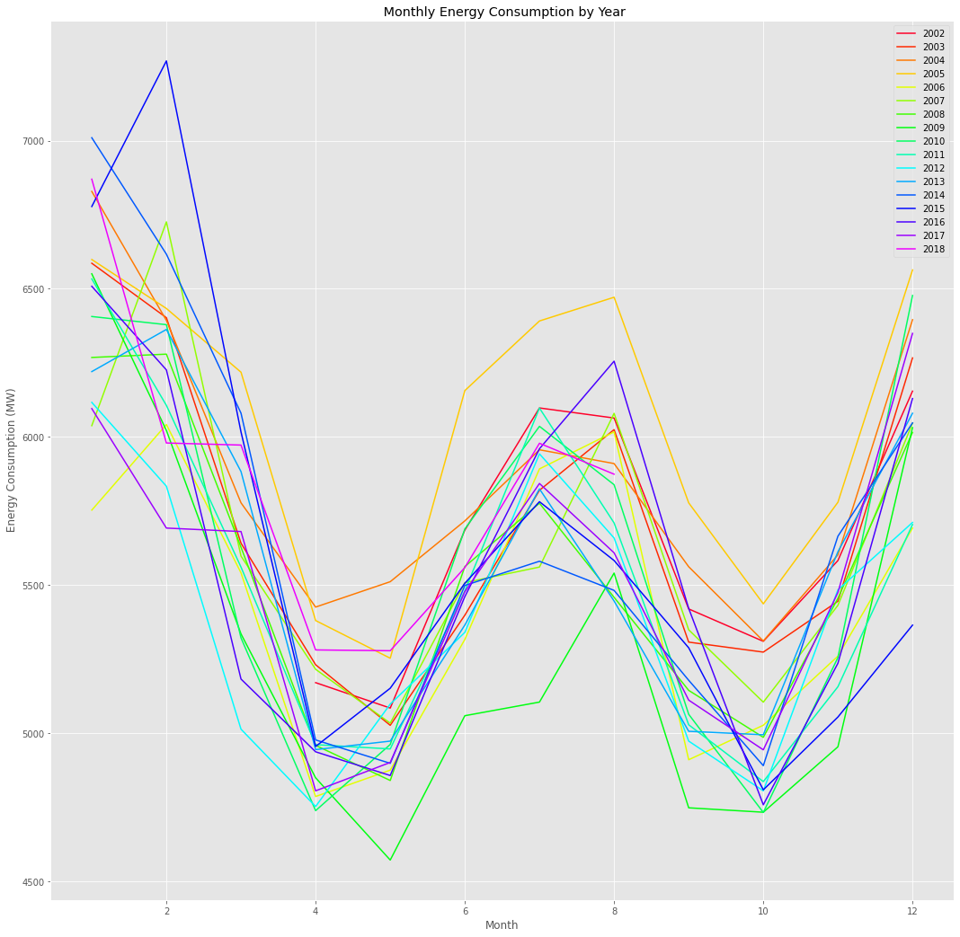
Seasonal Plot

Slide 20
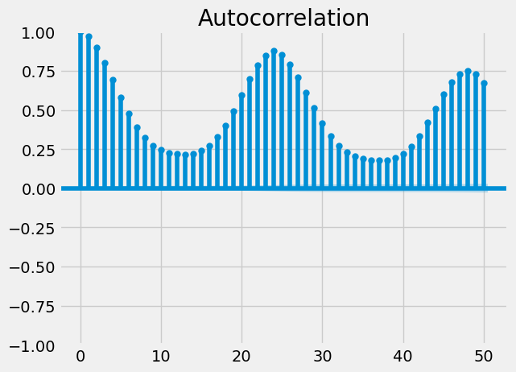
ACF Plot

Slide 21
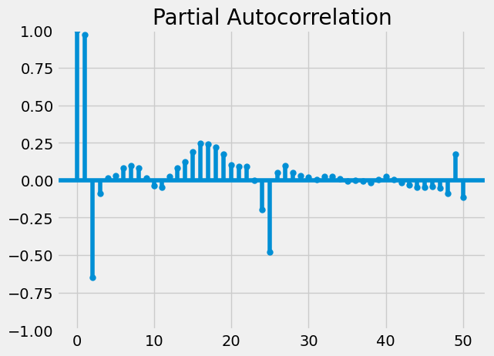
PACF Plot

Slide 22
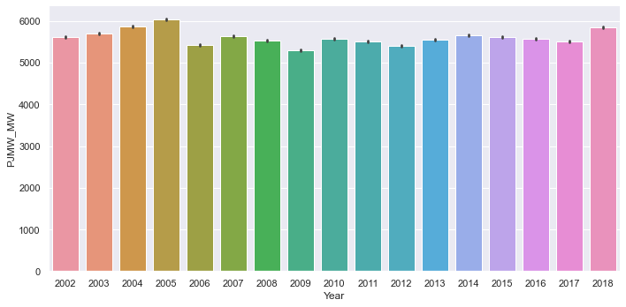
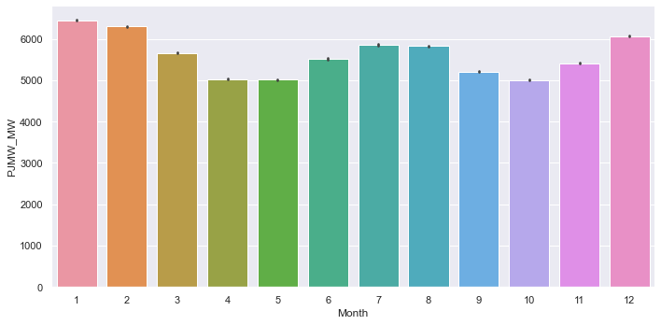
Cat Plots

Slide 23
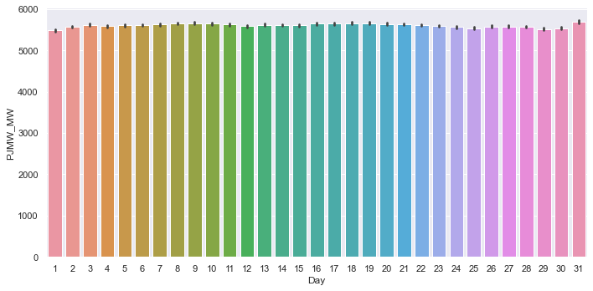
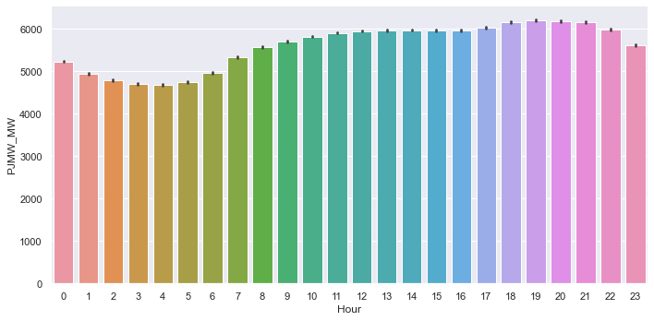

Slide 24
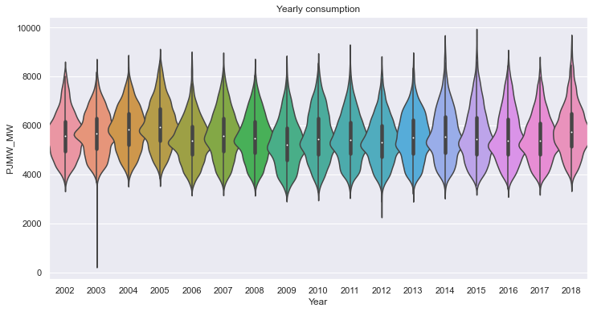
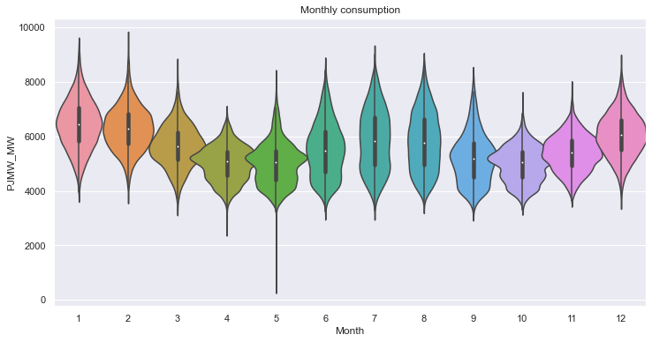
Violin Plot

Slide 25
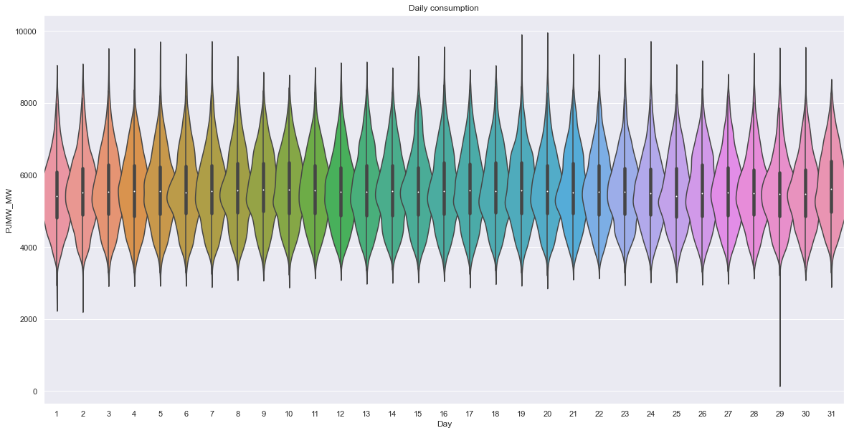
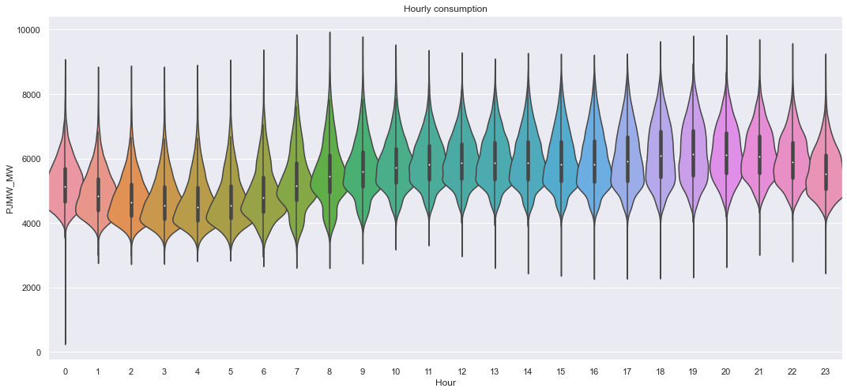
Violin Plot

Slide 26
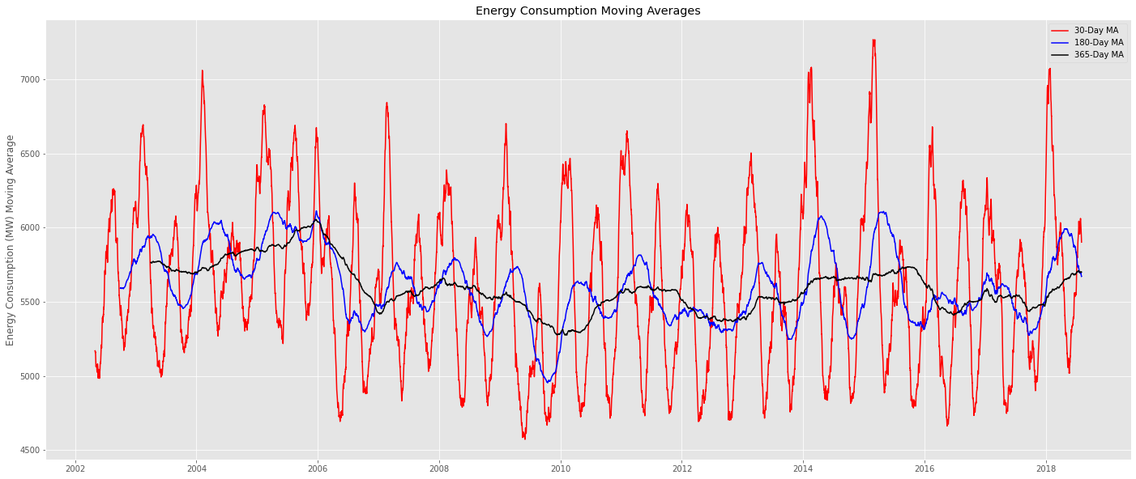
Moving Average

Slide 27
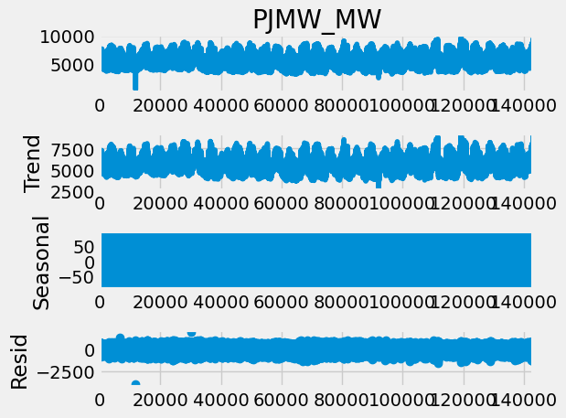
Time Series Decomposition

Slide 28
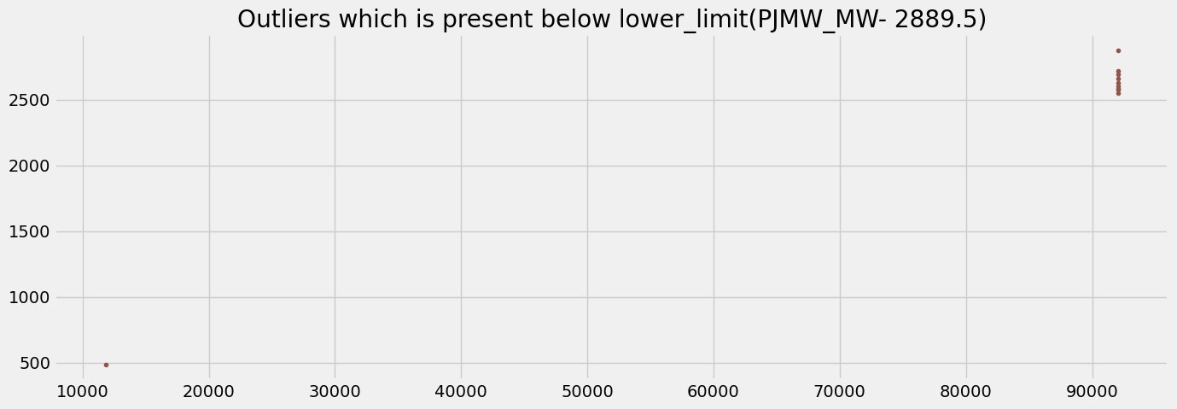
Outlier Detection

Slide 29
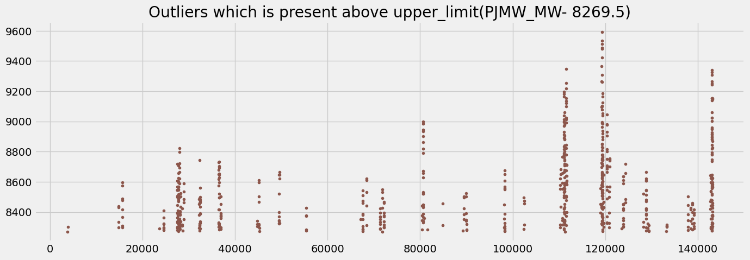

Slide 30
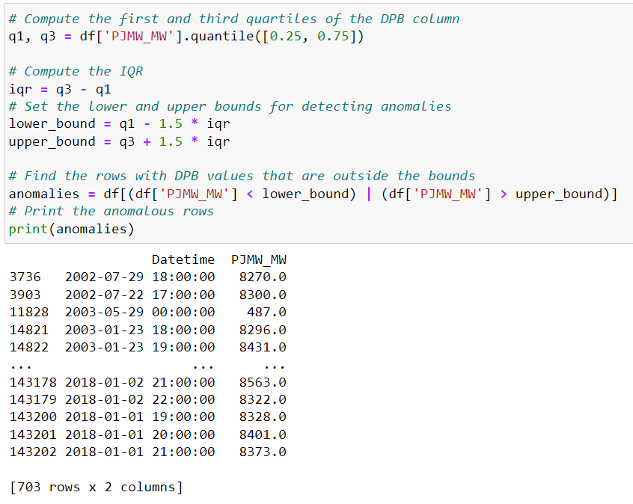
Anomaly Detection & Treatment

Slide 31
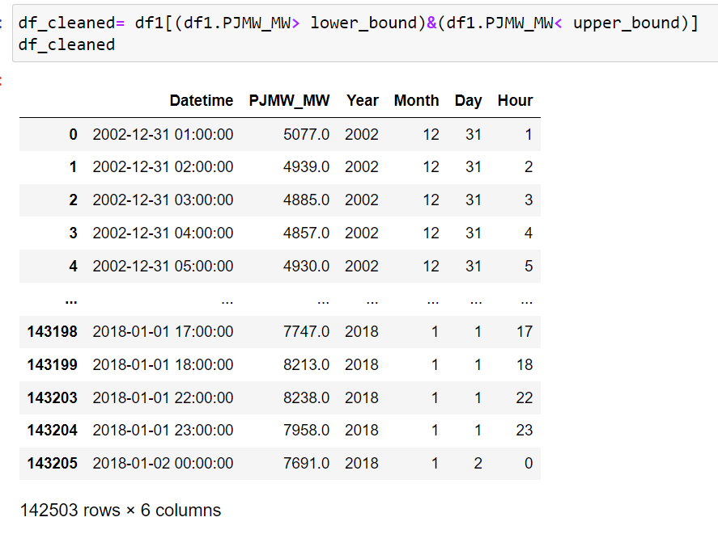
Outlier Removal

Slide 32
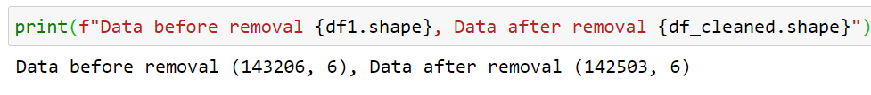

Slide 33
PHASE - 2
MODEL BUILDING

Slide 34
MODELS BUILT:
:
PROPHET MODEL
XGBOOST
LINEAR REGRESSION
RANDOM FOREST
DEEP NEURAL NETWORK

Slide 35
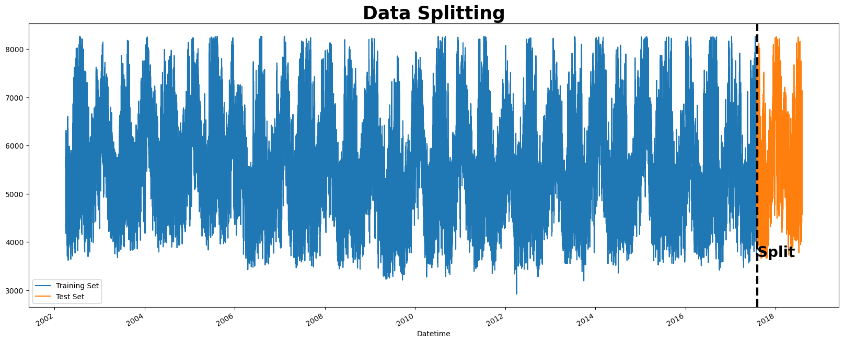
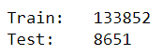
Splitting the data set

Slide 36
PROPHET MODEL
Prophet is an open-source library for univariate (one variable) time series forecasting developed by Facebook. It works best with time series that have strong seasonal effects and several seasons of historical data.

Slide 37
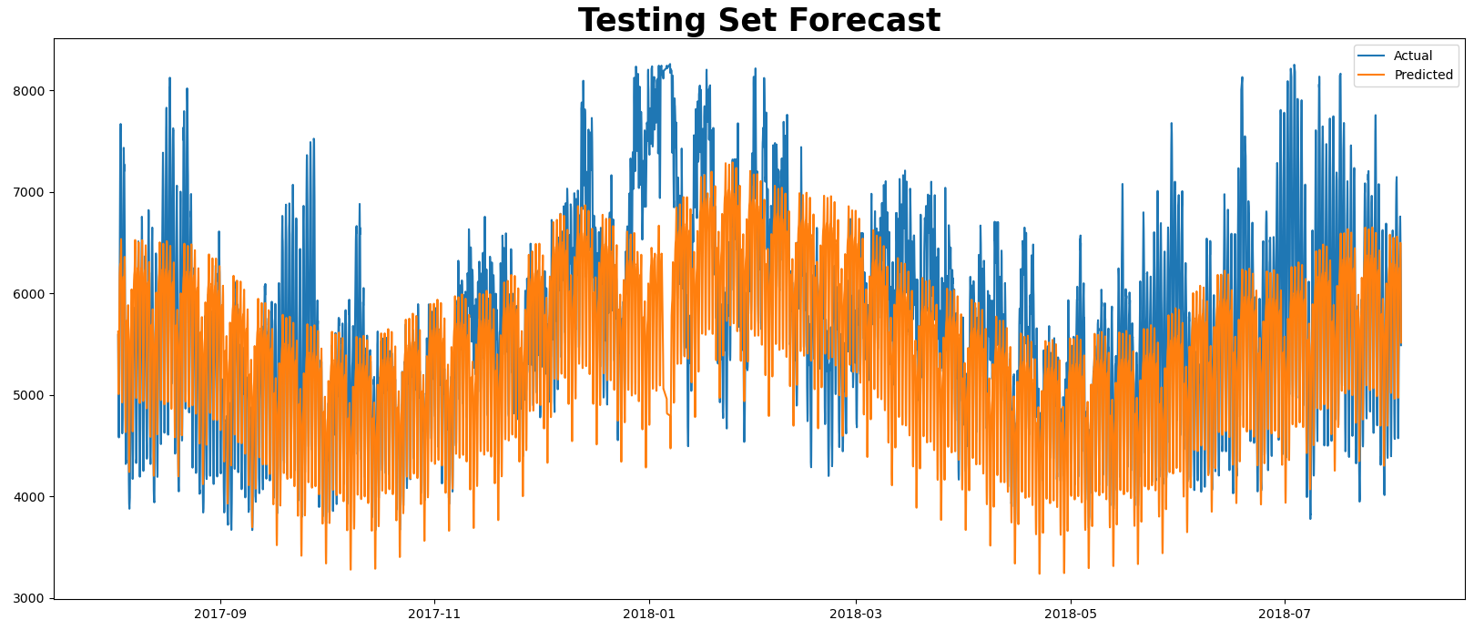
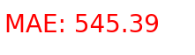
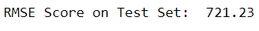

Slide 38
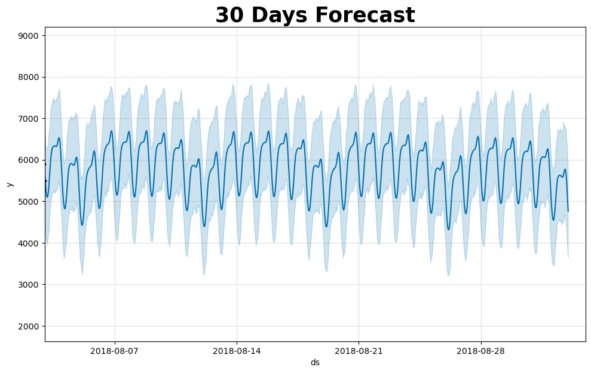

Slide 39
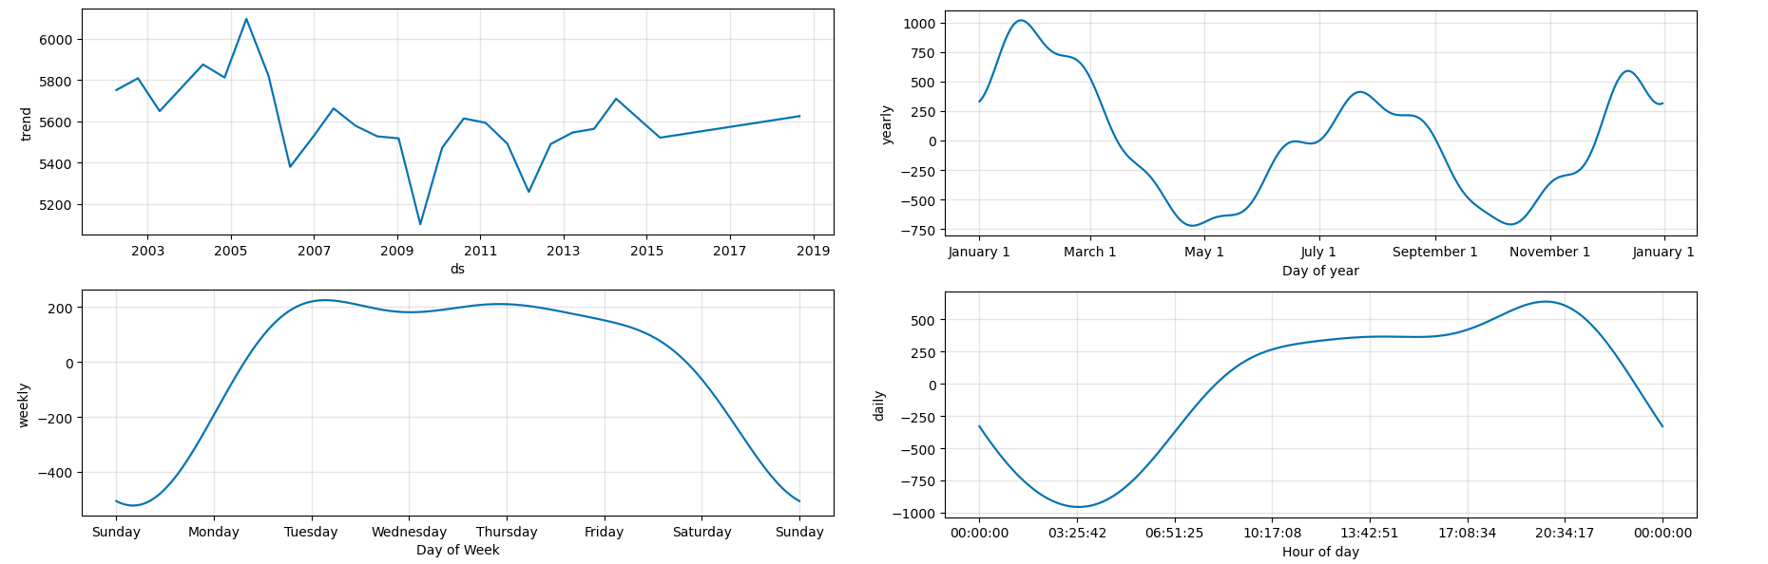

Slide 40
2. XGBOOST MODEL
XGBoost is short for Extreme Gradient Boosting and is an efficient implementation of the stochastic gradient boosting machine learning algorithm. The stochastic gradient boosting algorithm, also called gradient boosting machines or tree boosting, is a powerful machine learning technique that performs well or even best on a wide range of challenging machine learning problems.
To be able to use XGBoost for time series forecasting, the data should be transformed into supervised learning before feeding it into the model.

Slide 41
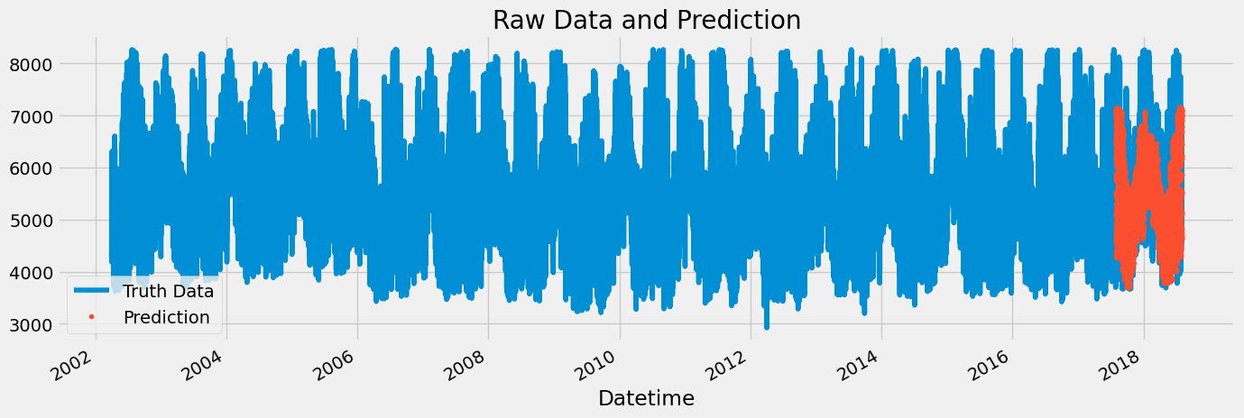

Slide 42
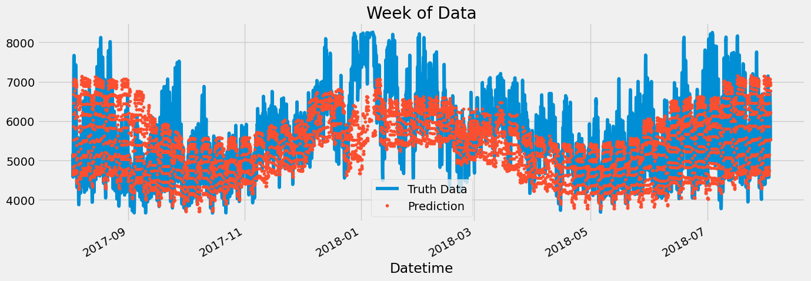
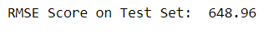

Slide 43
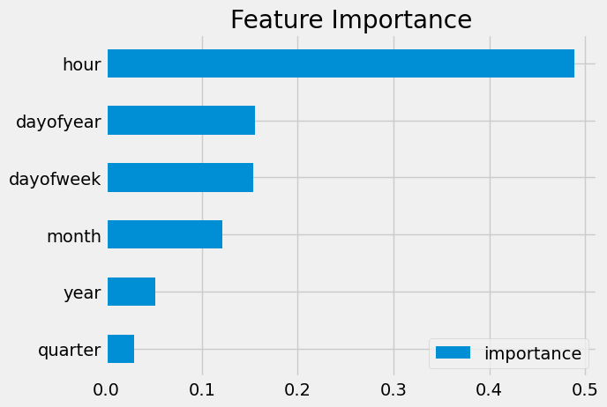

Slide 44
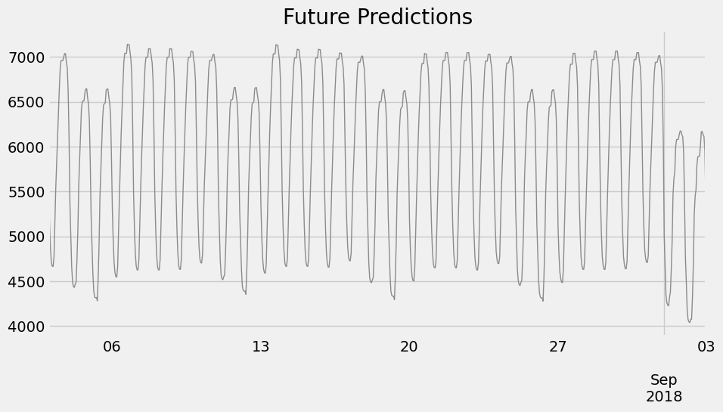

Slide 45
3. LINEAR REGRESSION
Linear regression is a quiet and the simplest statistical regression method used for predictive analysis in machine learning. Linear regression shows the linear relationship between the independent(predictor) variable i.e. X-axis and the dependent(output) variable i.e. Y-axis, called linear regression. If there is a single input variable X(independent variable), such linear regression is called simple linear regression.

Slide 46

DATA SET
X = energy consumption in a week

Slide 47

Y = Daily energy consumption data

Slide 48

Prediction has been done with test data

Slide 49

Forecasting

Slide 50
Predicted RMSE,MAE,MAPE
RMSE | MAE | MAPE
354.2 | 274.32 | 4.767
Forecasted RMSE,MAE,MAPE
RMSE | MAE | MAPE
588.8 | 462.2 | 8.26

Slide 51
4. RANDOM FOREST
Random forest is a Supervised Machine Learning Algorithm that is used widely in Classification and Regression problems. It builds decision trees on different samples and takes their majority vote for classification and average in case of regression. One of the most important features of the Random Forest Algorithm is that it can handle the data set containing continuous variables, as in the case of regression, and categorical variables, as in the case of classification. It performs better for classification and regression tasks.

Slide 52

Prediction has been done with test data

Slide 53

Forecasting

Slide 54

Forecasting for next 30 days

Slide 55
Predicted RMSE,MAE,MAPE
RMSE | MAE | MAPE
368.30 | 284.39 | 4.902
Forecasted RMSE,MAE,MAPE
RMSE | MAE | MAPE
548.31 | 438.01 | 7.775

Slide 56
5. DEEP NEURAL NETWORK
The Deep Learning framework we are using is Tensorflow. Before feeding the data into Neural Network, we have to do some modification to the data so they can be accepted by the model.
We are going to use windowing technique which basically group the data into feature and label. The label will be the next value. You can take a look at the next few cells to give an idea what we are going to do

Slide 57



Slide 58


Slide 59

Findings
Based on our finding, we can see RANDOM FOREST model has less errors (RMSE, MAE, MAPE).
So forecasted power consumption for next 30 days from 2018-08-03 using RANDOM FOREST.

Slide 60
PHASE - 3
MODEL DEPLOYMENT

Slide 61

DEPLOYED MODEL :
:
The model is deployed on Streamlit framework and the Integrated Development Environment (IDE) used for its development was Spider.

Slide 62


